Slide 1
CSCI 3412 Algorithm
Module 10: Elementary Data Structures ++

Slide 2

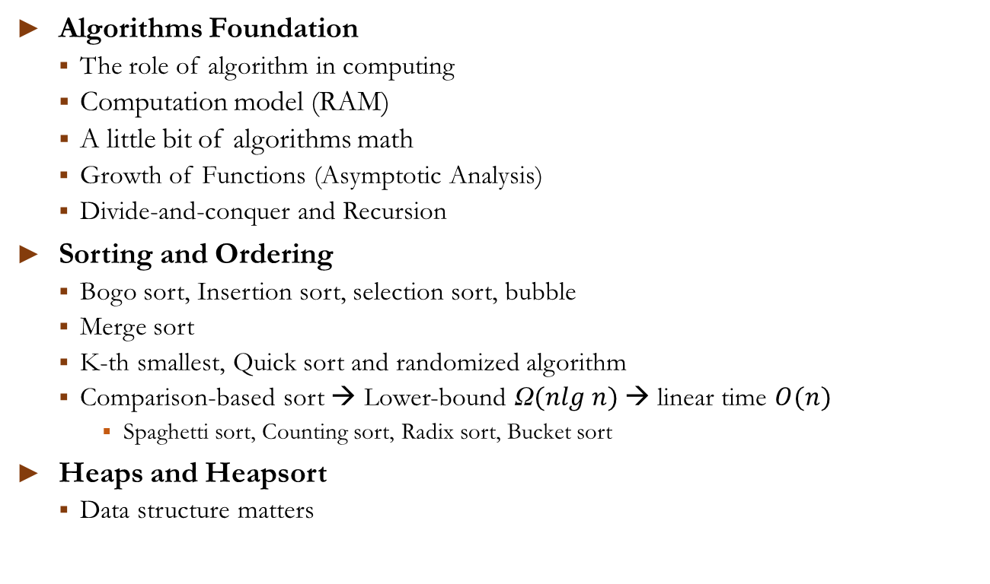
We learned so far …
Algorithms Foundation
The role of algorithm in computing
Computation model (RAM)
A little bit of algorithms math
Growth of Functions (Asymptotic Analysis)
Divide-and-conquer and Recursion
Sorting and Ordering
Bogo sort, Insertion sort, selection sort, bubble sort
Merge sort
K-th smallest, Quick sort and randomized algorithm
Comparison-based sort → Lower-bound Ω$(nlg n)$→ linear time $O(n)$
Spaghetti sort, Counting sort, Radix sort, Bucket sort
Heaps and Heapsort
Data structure matters

Slide 3

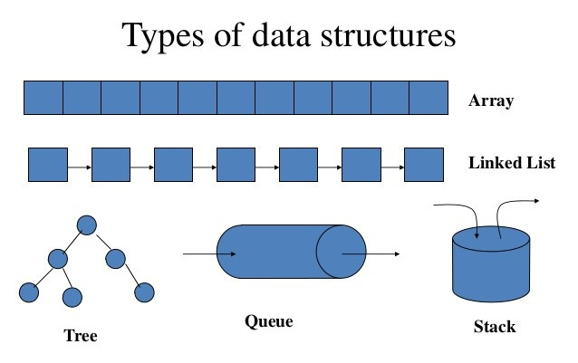
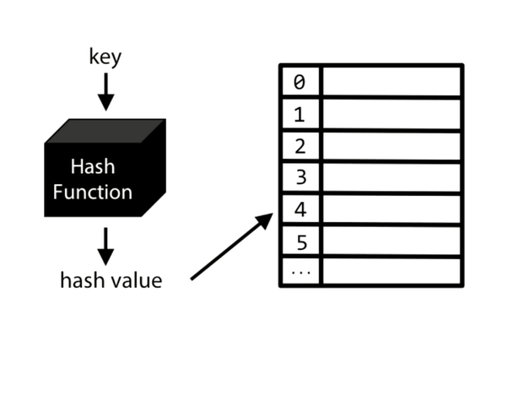
Today and on …
Data structures:
Survey of Elementary Data Structure
Stacks, Queues, Linked Lists, and Trees
Try to avoid the basics that you’ve already learned
Hash Table (Dictionary ADT)
Binary Search Trees
Balance (Red-Black) Trees

Slide 4
Abstract data types (ADT):
ADT: Focus on the abstraction of a data structure
Specifies “functionality”
Data attributes and structures
Operations it can perform
Data Types
Stacks
Capped-capacity
Expandable
Amortized analysis for expandable stacks
Queues: types of queues
Lists
Sentinel – reducing coefficient is also important
Trees
BST: Binary Search Tree
Dictionaries
Search items by key values, not by indexes

Slide 5
Stacks
Operations, expandable stack, cost amortization

Slide 6
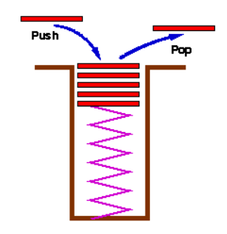
Stacks
Behavior: LIFO (last-in first-out)
Stores
arbitrary objects using pointers and templates
Operations
push: adds object
pop: removes (and returns) the last element
peek: fetch the element at the top of stack
isEmpty
size
Implemented
Linked list, static array, dynamic array
In C++, it’s an adapters-based on other sequence containers (deque: Doubly Ended Queue)
Exceptions
Overflow
Underflow
Which is better?
item pop()
vs.
item peek() & bool pop()

Slide 7
Capped-Capacity Stacks
Static array-based Stack
Store objects in an array
keep pointer to the last inserted object
Problem?
Size of stack bounded by size of array
Need to check stack underflow (empty stack) and stack overflow

Slide 8
Expandable Stacks (Dynamic Array)
Capped-capacity stack is fast but not useful in practice
How can we design an uncapped Stack like dynamic array, vector in C++, lists in Python?
Strategy #1: Incremental
Increase the size of array by constant c when the stack is full
Strategy #2: Doubling
Double size of array when the stack is full
Static arrays can’t be resized. Why?
It can only be re-allocated & copied. Efficiency?

Slide 9
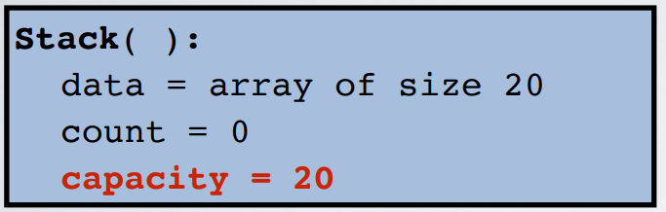
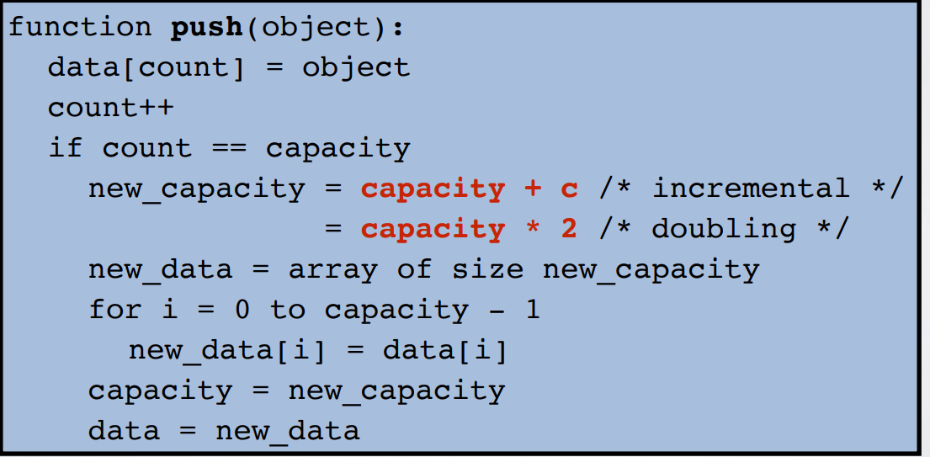
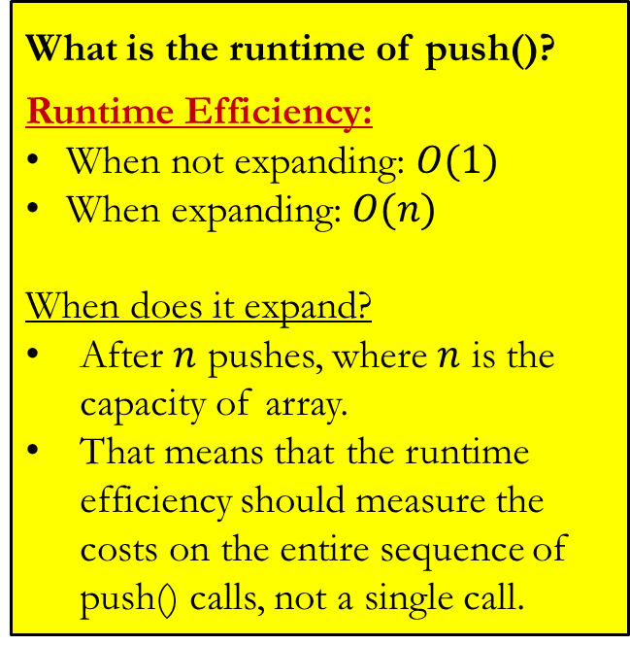
Expandable (static) Stacks
What is the runtime of push()?
Runtime Efficiency:
When not expanding: $O(1)$
When expanding: $O(n)$
When does it expand?
After $n$ pushes, where $n$ is the capacity of array.
That means that the runtime efficiency should measure the costs on the entire sequence of push() calls, not a single call.
:
:

Slide 10
Amortization/Depreciation
Amortization (Accounting terminology)
Amortization is a method of
spreading the cost of an intangible asset
over a specific period of time, which is usually the course of its useful life
For example, the cost of intangible assets (e.g., licenses, patents, trademarks, copyrights) will be expensed each period equally. If Company ABC obtains a $10,000 license that expires in 5 years, it will be labeled as a $2,000 amortization expense each year

Slide 11
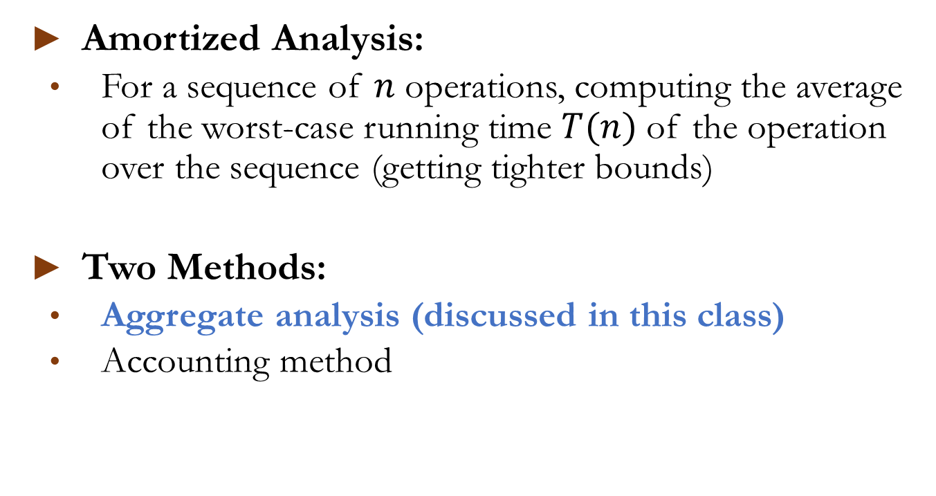
Amortized Analysis
Amortized Analysis:
For a sequence of $n$ operations, computing the average of the worst-case running time $T(n)$ of the operation over the sequence (getting tighter bounds)
Two Methods:
Aggregate analysis (discussed in this class)
Accounting method

Slide 12
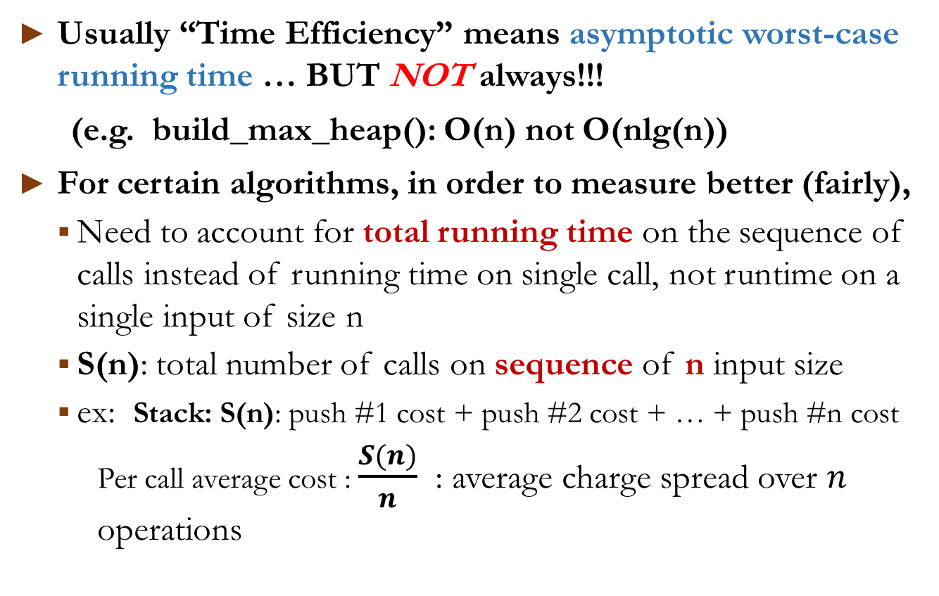
Amortized Analysis of stacks
Usually “Time Efficiency” means asymptotic worst-case running time … BUT NOT always!!!
(e.g. build_max_heap(): O(n) not O(nlg(n))
For certain algorithms, in order to measure better (fairly),
Need to account for total running time on the sequence of calls instead of running time on single call, not runtime on a single input of size n
S(n): total number of calls on sequence of n input size
ex: Stack: S(n): push #1 cost + push #2 cost + … + push #n cost
Per call average cost : $\frac{S(n)}{n}$ : average charge spread over $n$ operations

Slide 13
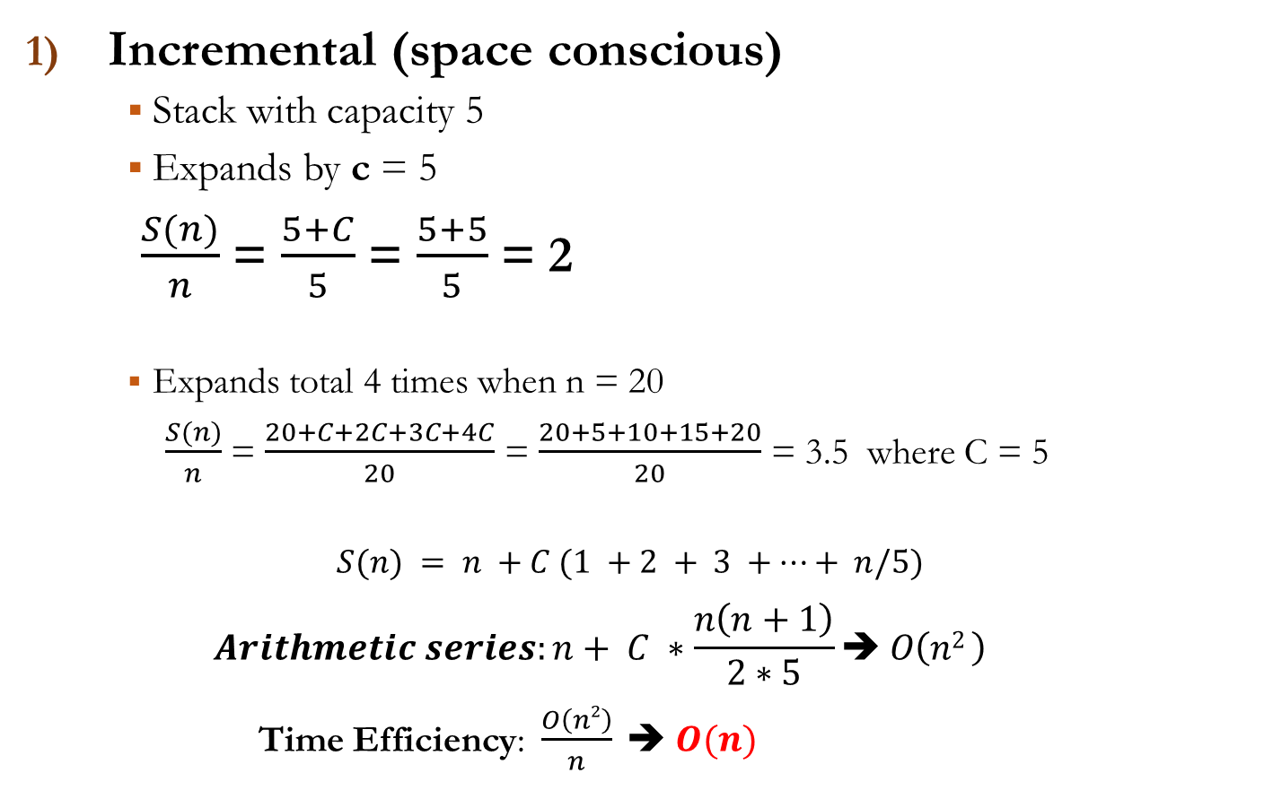
Amortized Analysis (Aggregated Method)
Incremental (space conscious)
Stack with capacity 5
Expands by c = 5
$\frac{S(n)}{n}$ = $\frac{5+C}{5}$ = $\frac{5+5}{5}$ = 2
Expands total 4 times when n = 20
$\frac{S(n)}{n}$ = $\frac{20+C+2C+3C+4C}{20}$ = $\frac{20+5+10+15+20}{20}$ = 3.5 where C = 5
$$S(n) = n +C (1 +2 + 3 +…+ n/5)$$
$$Arithmetic series:n+ C ∗\frac{n\left(n+1\right)}{2∗5}➔ O\left(n2 \right)$$
Time Efficiency: $\frac{O\left(n2\right)}{n} ➔ O(n)$
Total cost of n pushes: S(n) = O (n²)
Amortized cost of n pushes: S(n)/n = O (n)
Cost of 5 store ops
Cost of expansion (copying existing data)

Slide 14
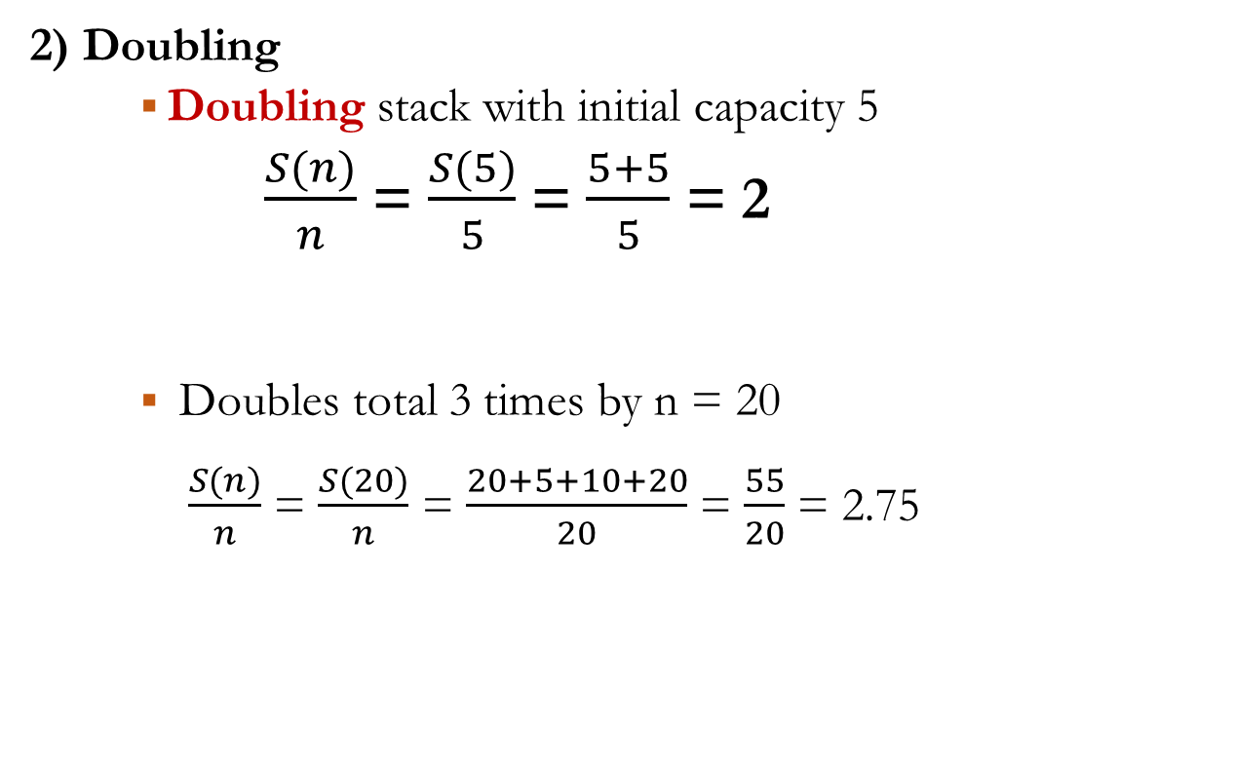
Amortized Analysis (Aggregated Method)
2) Doubling
Doubling stack with initial capacity 5
$\frac{S(n)}{n}$ = $\frac{S(5)}{5}$ = $\frac{5+5}{5}$ = 2
Doubles total 3 times by n = 20
$\frac{S(n)}{n}$ = $\frac{S(20)}{n}$ = $\frac{20+5+10+20}{20}$ = $\frac{55}{20}$ = 2.75
Cost of 5 store ops
Cost of expansion (copying existing data)

Slide 15
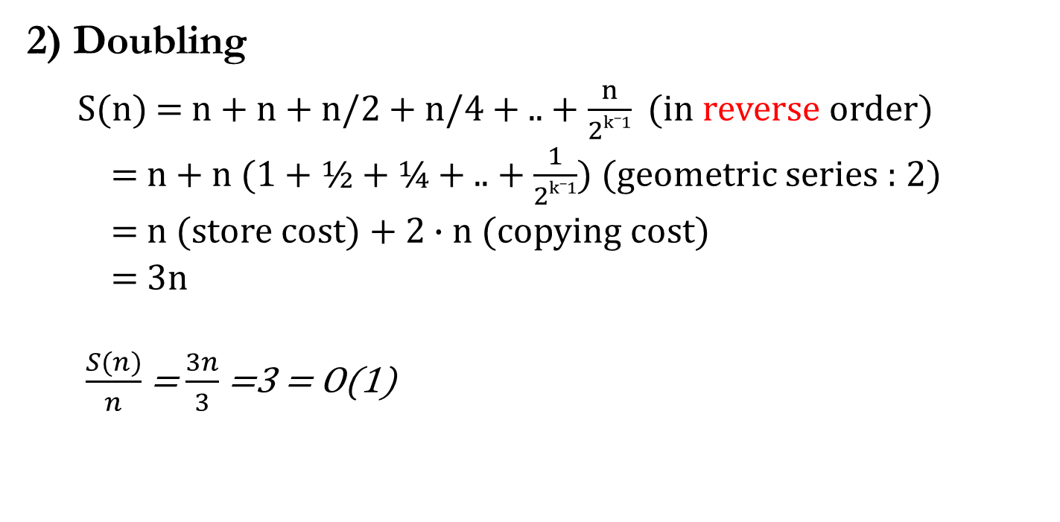
Amortized Analysis (Aggregated Method)
2) Doubling
$S(n)$ = n + n + n/2 + n/4 + .. + $\frac{n}{2k_1}$ (in reverse order)
= n + n (1 + ½ + ¼ + .. +$\frac{1}{2k_1}$) (geometric series : 2)
= n (store cost) + 2 $∙n$ (copying cost)
= 3n
$\frac{S(n)}{n}$ = $\frac{3n}{3}$ =3 = O(1)

Slide 16
Amortized Analysis: Summary
Each past operation adds some credit
Need to accumulate enough credits to execute slow operation
Amortized Cost for increasing dynamic array size
Incremental: O(n²) / n = O(n) : arithmetic series
Doubling: S(n) = O(n) O(n) / n = O(1) : geometric series
Doubling is the winner
The same analysis can go with any data structure based on a dynamically growing array.

Slide 17
Queues
Operations, types of queues

Slide 18
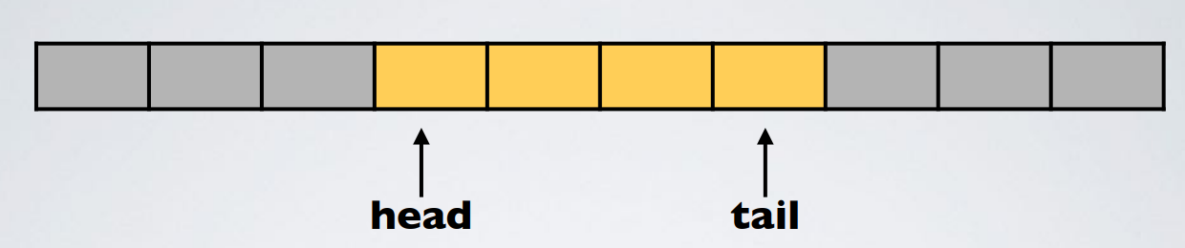
Queues
FIFO behavior
Supported operations:
enqueue(object):
dequeue(object):
size()
isEmpty()
Can be implemented with expandable (dynamic) array
Need to keep track of head and tail
What happens when tail reaches end?
Is the queue full?
So, when should we expand array?
Wrap around until array is completely full
When expanding, re-order objects properly
dequeue() enqueue()

Slide 19
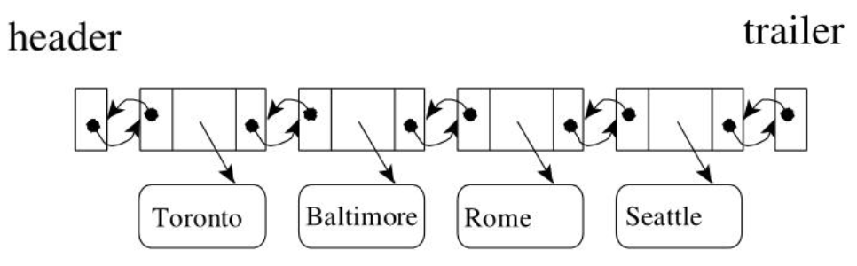
Modified Queues
Circular Queue: Elements are represented in circular fashion. Insertion is done at very first location if last location is full. (modulo operator)
Doubly Ended Queue (deque, pronounced deck): Elements can be inserted or deleted from either end. Supports both stack and queue operations in C++. Usually implemented using doubly-linked list.
Priority Queue : Each element is assigned with a priority. An element with higher priority is processed first. (Not chronological order)

Slide 20
Linked Lists
Operations, types of Linked lists

Slide 21
Linked Lists
A linked list is an ordered set consisting of a varying number of elements (nodes) linked by pointers.
Each node has two fields: data and next pointer.
A linked list overcomes the limitation of fixed size in an array.
A list may be linear (Stack, Queue) or non-linear (Tree, Graph)
Types of LL
1. Singly LL : traversed in one direction only
2. Doubly LL: Two “starting pointers” – allows traversal both forwards and backwards
3. Circular LL: pointer in the last node points back to the first node. Be careful not to traverse infinitely
4. Circular DLL : circular + doubly LL

Slide 22
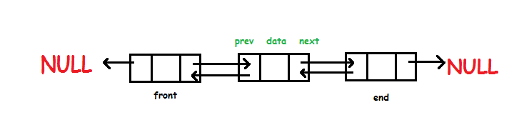
Performance: Static Array vs. DLL
 | Static Array | Doubly Linked List
Data Structure | 0 1 2 3 … n
Inserting a new key at a specified position (index) | Sorted: O(1) + O(n) Unsorted: O(1) + O(n) | Sorted: O(1) + O(1) Unsorted: O(1) + O(1)
Deleting a key | Sorted: O(lg(n)) + O(n) Unsorted: O(n) + O(n) | Sorted: O(n) + O(1) Unsorted: O(n) + O(1)
Searching a key | Sorted: O(lg(n)) Unsorted: O(n) | Sorted: O(n) Unsorted: O(n)
*** HW 4 Part 2 for more exercises

Slide 23
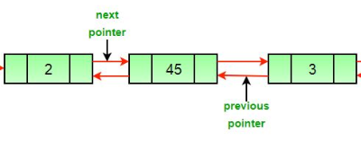
Doubly Linked Lists
Operations:
Why doubly linked list?
Searching list: O(n) – no binary search
Insertion at the specified position: O(1)
Deletion: O(n) to search the item to delete, then O(1) for deletion
def deleteNode(self, dele): #DLL
if self.head is None or dele is None: return
# If node to be deleted is head node
if self.head == dele: self.head = dele.next
# Change next only if node to be deleted is NOT the last node
if dele.next is not None: dele.next.prev = dele.prev
# Change prev only if node to be deleted is NOT the first node
if dele.prev is not None: dele.prev.next = dele.next
Can we make delete () simpler without requiring special checking ?
dele.next.prev = dele.prev
dele.prev.next = dele.next

Slide 24
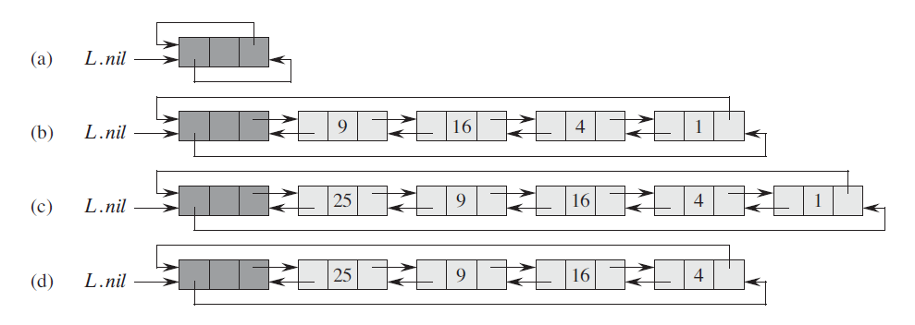
Linked Lists – Sentinels (CLRS: p 238)
Sentinel – a dummy object to eliminate boundary condition check
Its value is NULL but it has all the attributes of the other node in the list
It does not reduce the asymptotic time bounds of data
Then why?
It may reduce the coefficient from less checking
Not necessary for checking for dele.next is not None, dele.prev is not None
It also may enhance code readability and maintainability.

Slide 25
Trees
Operations, types of trees,

Slide 26
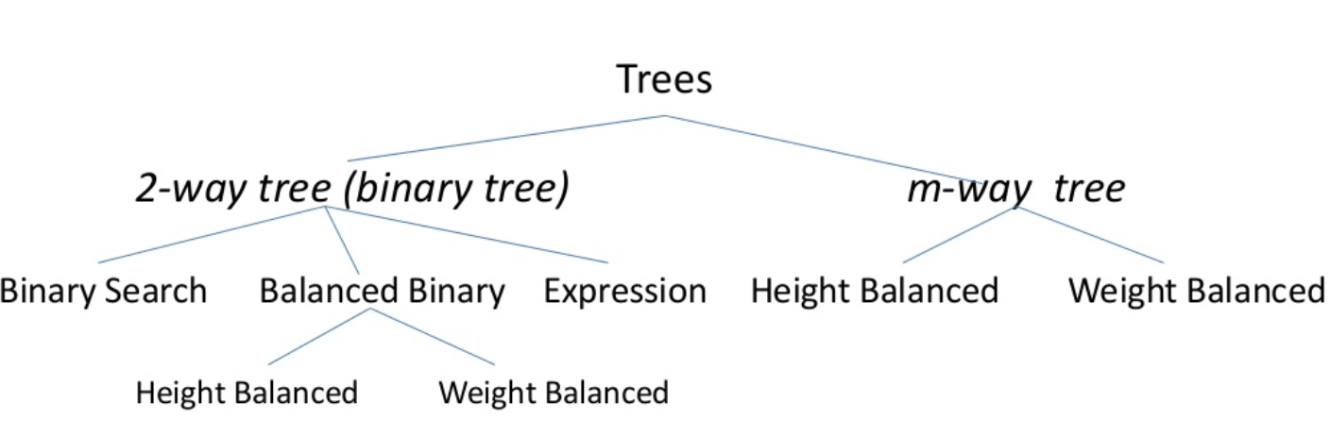
Trees, types of
A tree is a hierarchical (none-linear) representation of a finite set of one or more data items such that:
Special node : root of the tree
Data items are portioned into mutually exclusive subsets and each of which is itself a sub tree. (disjoint subsets)
Connected Acyclic Graph – no looping
One parent (root)

Slide 27
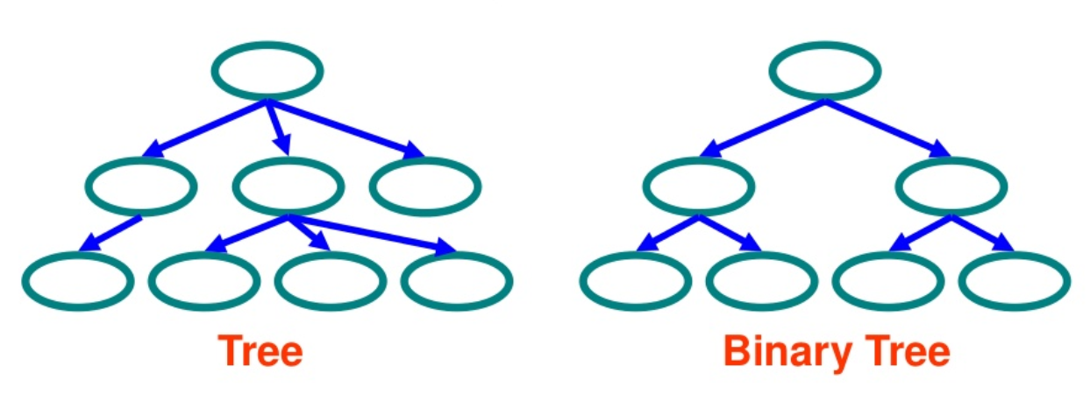
Tree Basics
Tree in general:
Nodes
Each node has 0 or more children
A node can have at most one parent
Binary tree
0-2 children per node
Some Terminologies
Root: no parent
Leaf: no child
Interior: non-leaf
Height: the number of edges of a longest path from a node to a leaf (downward) (a leaf node: 0).
The height of tree == the height of its root node
Depth: the number of edges of from a node to the root of a tree (upward) (a root node: 0)
Degree: maximum degree of nodes in a tree
Depth:1
Height:1
Depth: 0
Height:2
Level:
Root
Height
1
2
3
Interior
Leaf
Depth: 2
Height:0

Slide 28
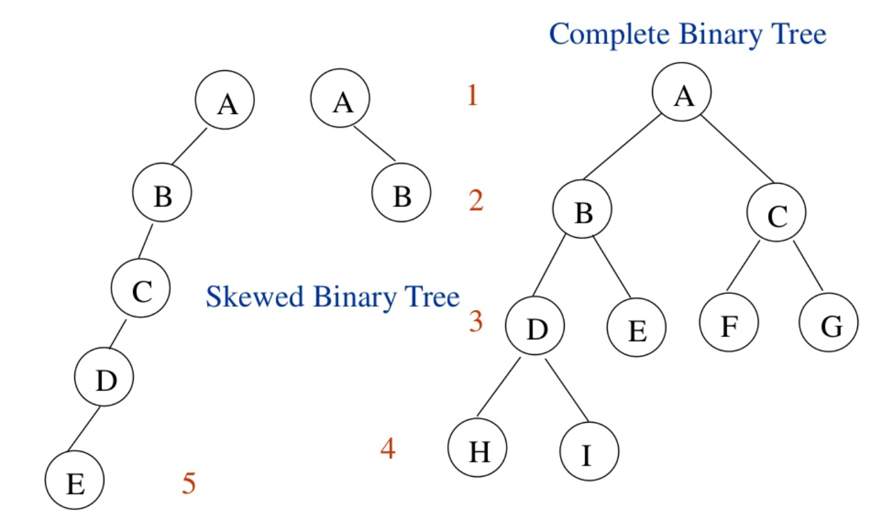
Samples of Trees
Depth: 1
Height:2
Depth: 2
Height:2
Tree Height, 2, 3, or 4 ?

Slide 29
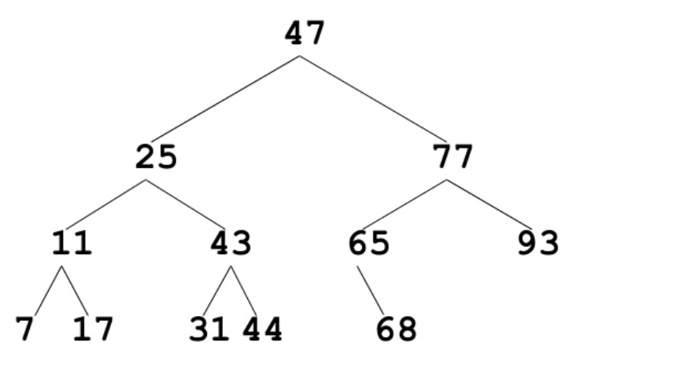
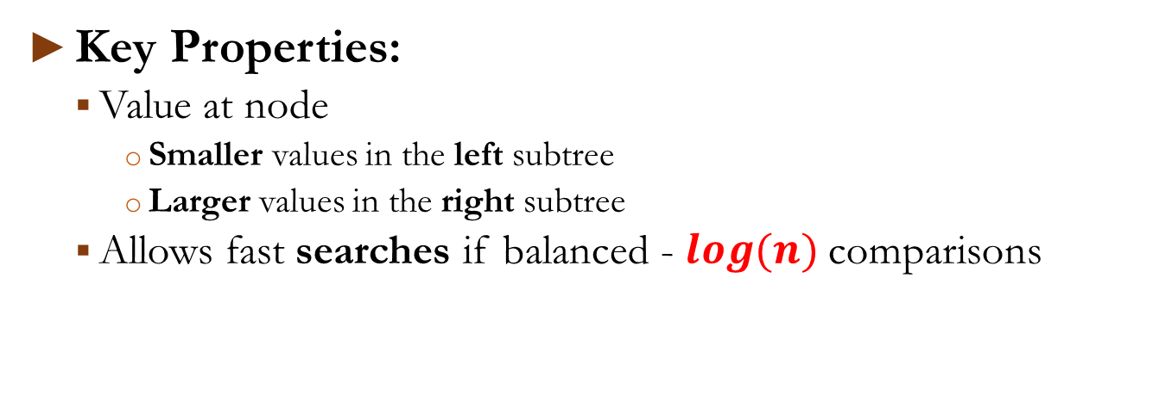
Binary Search Tree (BST)
Key Properties:
Value at node
Smaller values in the left subtree
Larger values in the right subtree
Allows fast searches if balanced - $\log{(n)}$comparisons

Slide 30
Tree Traversals (Based on the order of visiting parent)
Depending on the order of visiting parent node:
Preorder Traversal (parent → Left → Right)
Saving the tree (serialization of the tree) in BST
Inorder Traversal (Left → parent → Right)
Display the node values in ascending order in BST
Postorder Traversal (Left → Right → parent)
Postfix algebraic expression notation
Deleting a node

Slide 31
What’s coming next?
Another important ADT:
Dictionary ≡≡ Hash Table ≡≡ Map
After that, BST and Balanced BST

